Slide 1

WEEK 02 What is gis lecture
Instructor: Yanan Wu
fALL 2025

Slide 2
2.2 Feature classes and Map layers

Slide 3
GIS stores related geographic features as separate collections of files called feature classes
can be easily reused, assembled into any number of map compositions, and overlaid for analysis
are associated with attribute tables of data
When symbolized and displayed as part of a map, a feature class is called a map layer
14

Slide 4
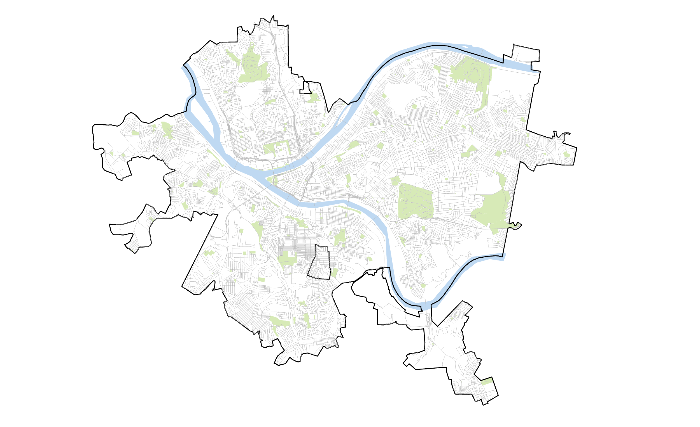
Physical features
(lakes, parks, rivers, roads, etc.)
4

Slide 5
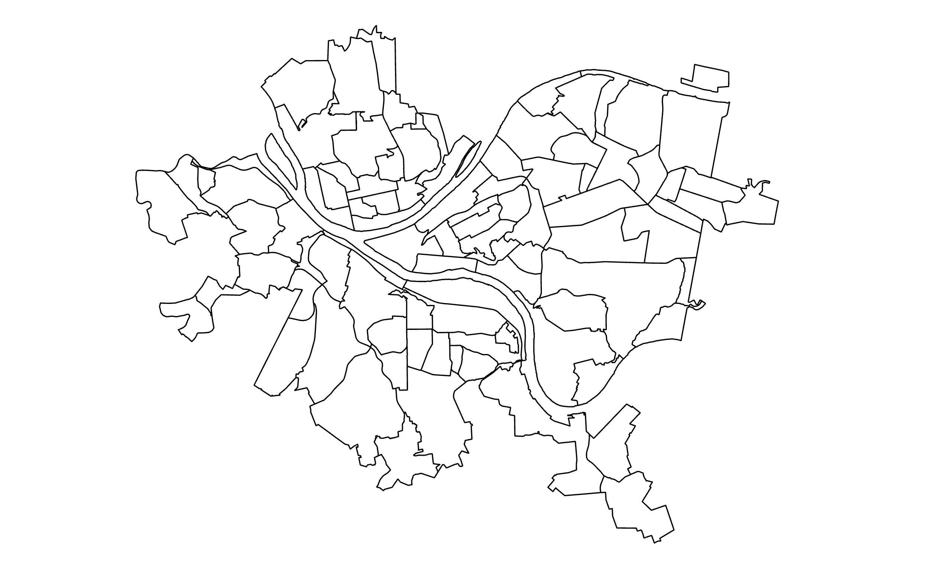
Political features
(states, provinces, municipalities, neighborhoods)
5

Slide 6
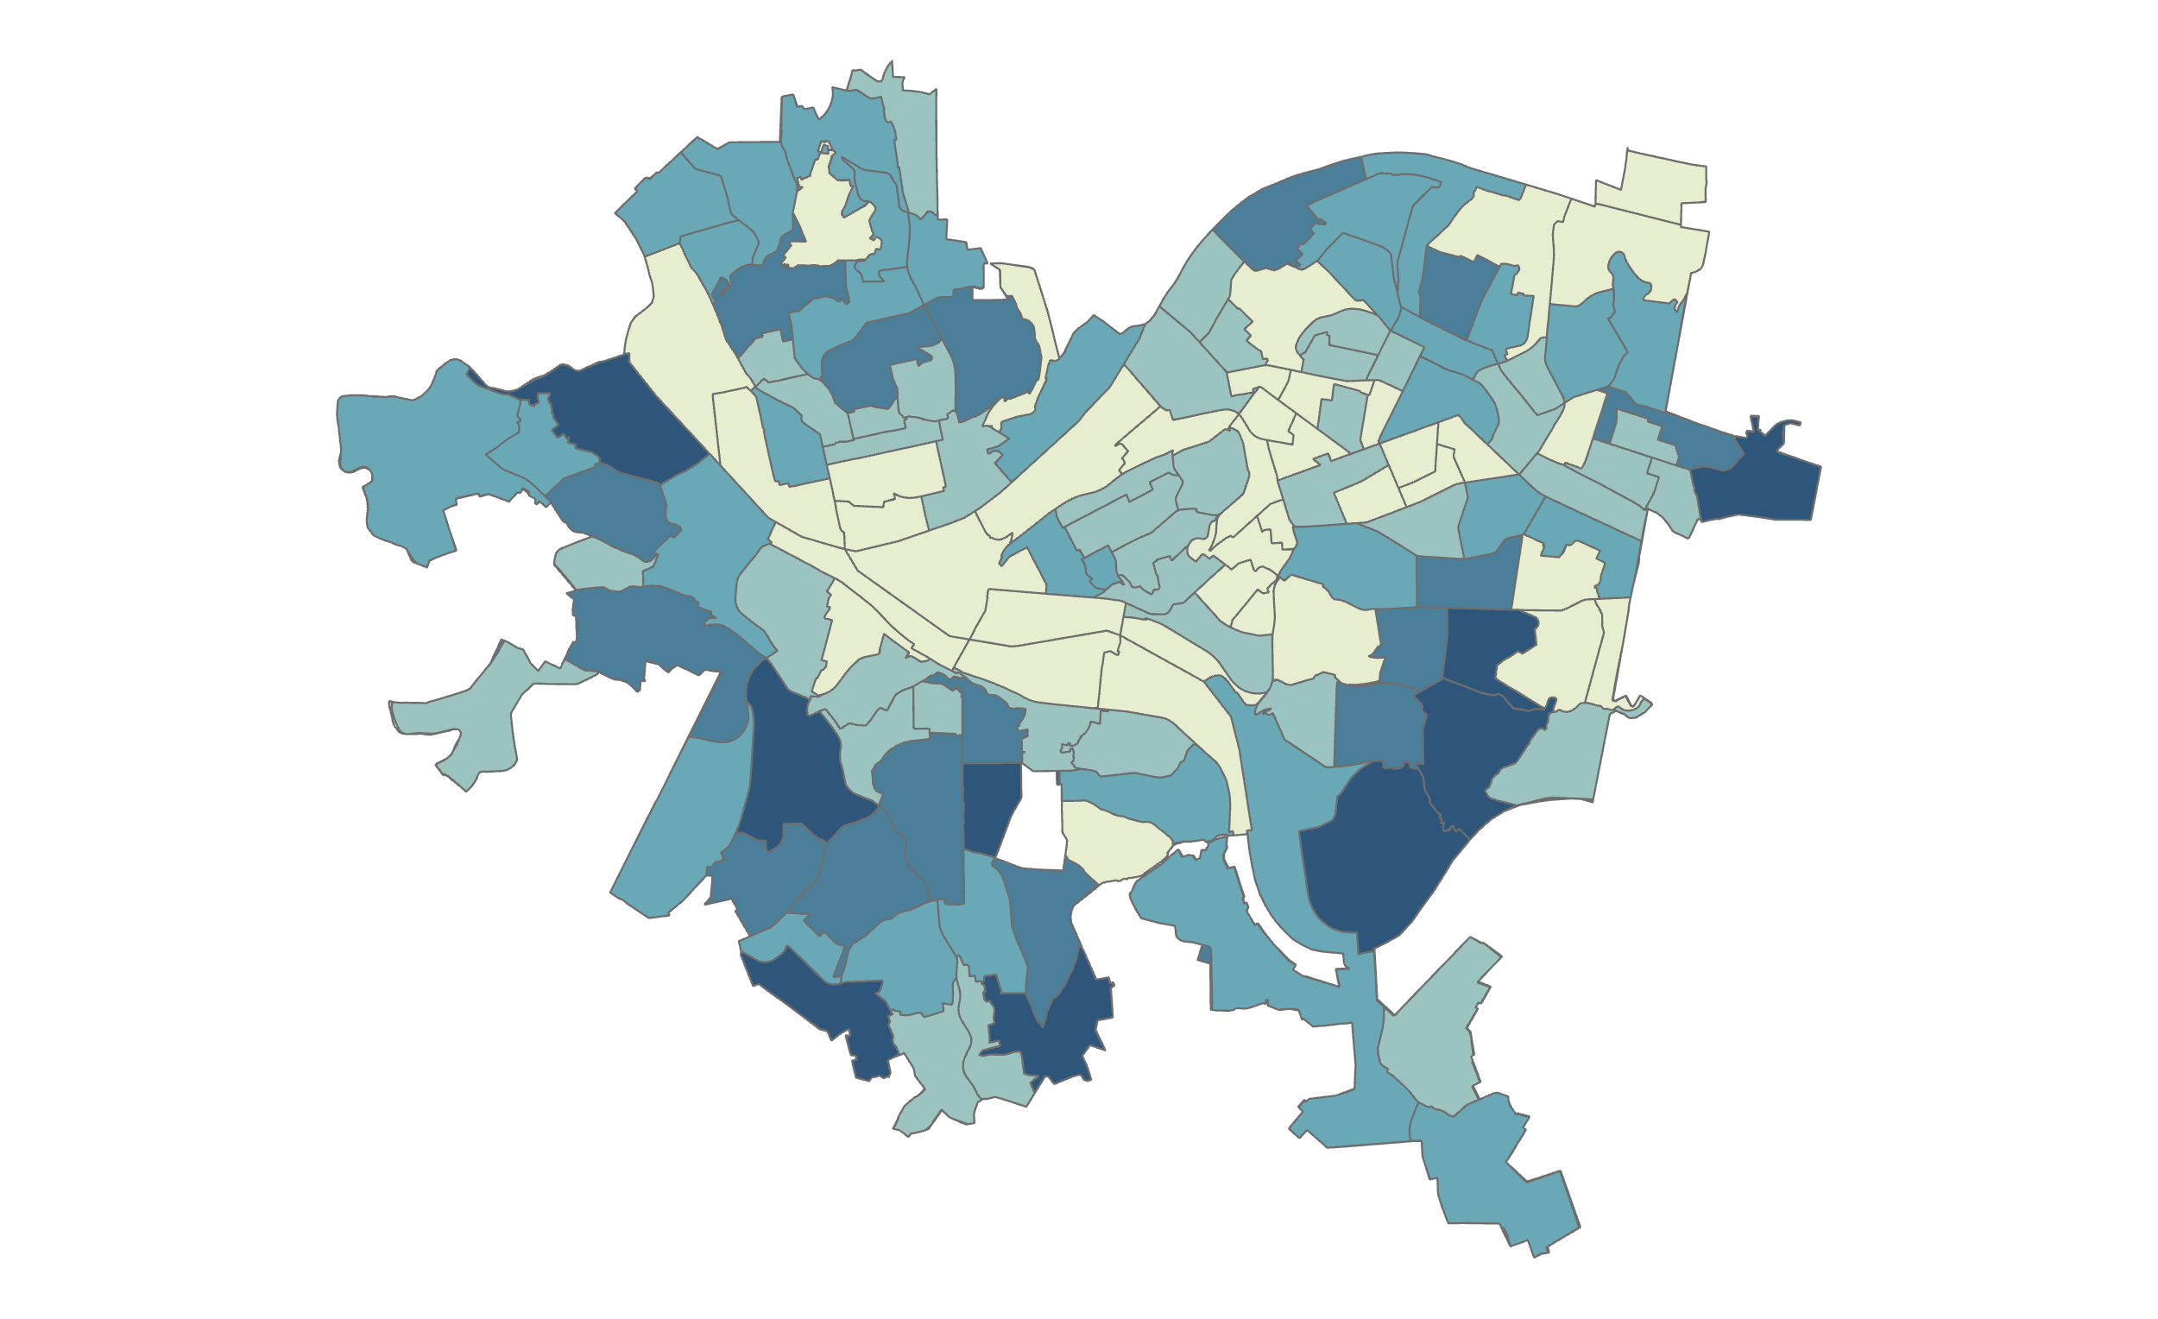
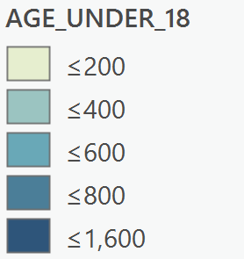
Statistical features
(Census tracts)
6

Slide 7
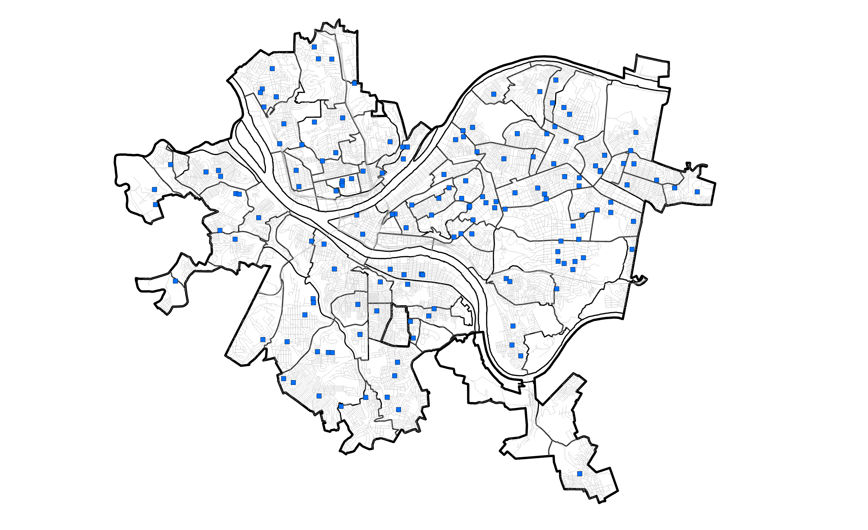
Administrative features
(schools, clinics, businesses, bus stops, etc.)
7

Slide 8
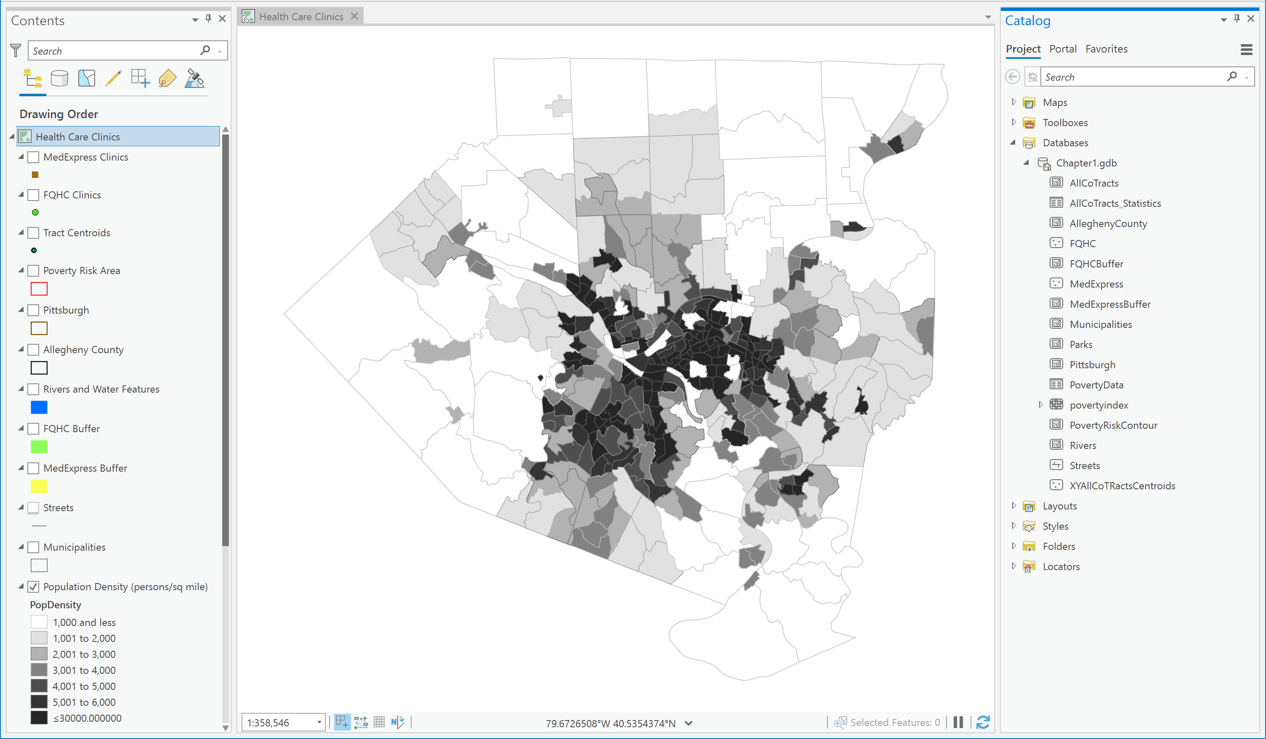
Layers and features as viewed in ArcGIS Pro
Feature Class
Z
Layer

Slide 9
2.3 ARCGIS ONLINE

Slide 10
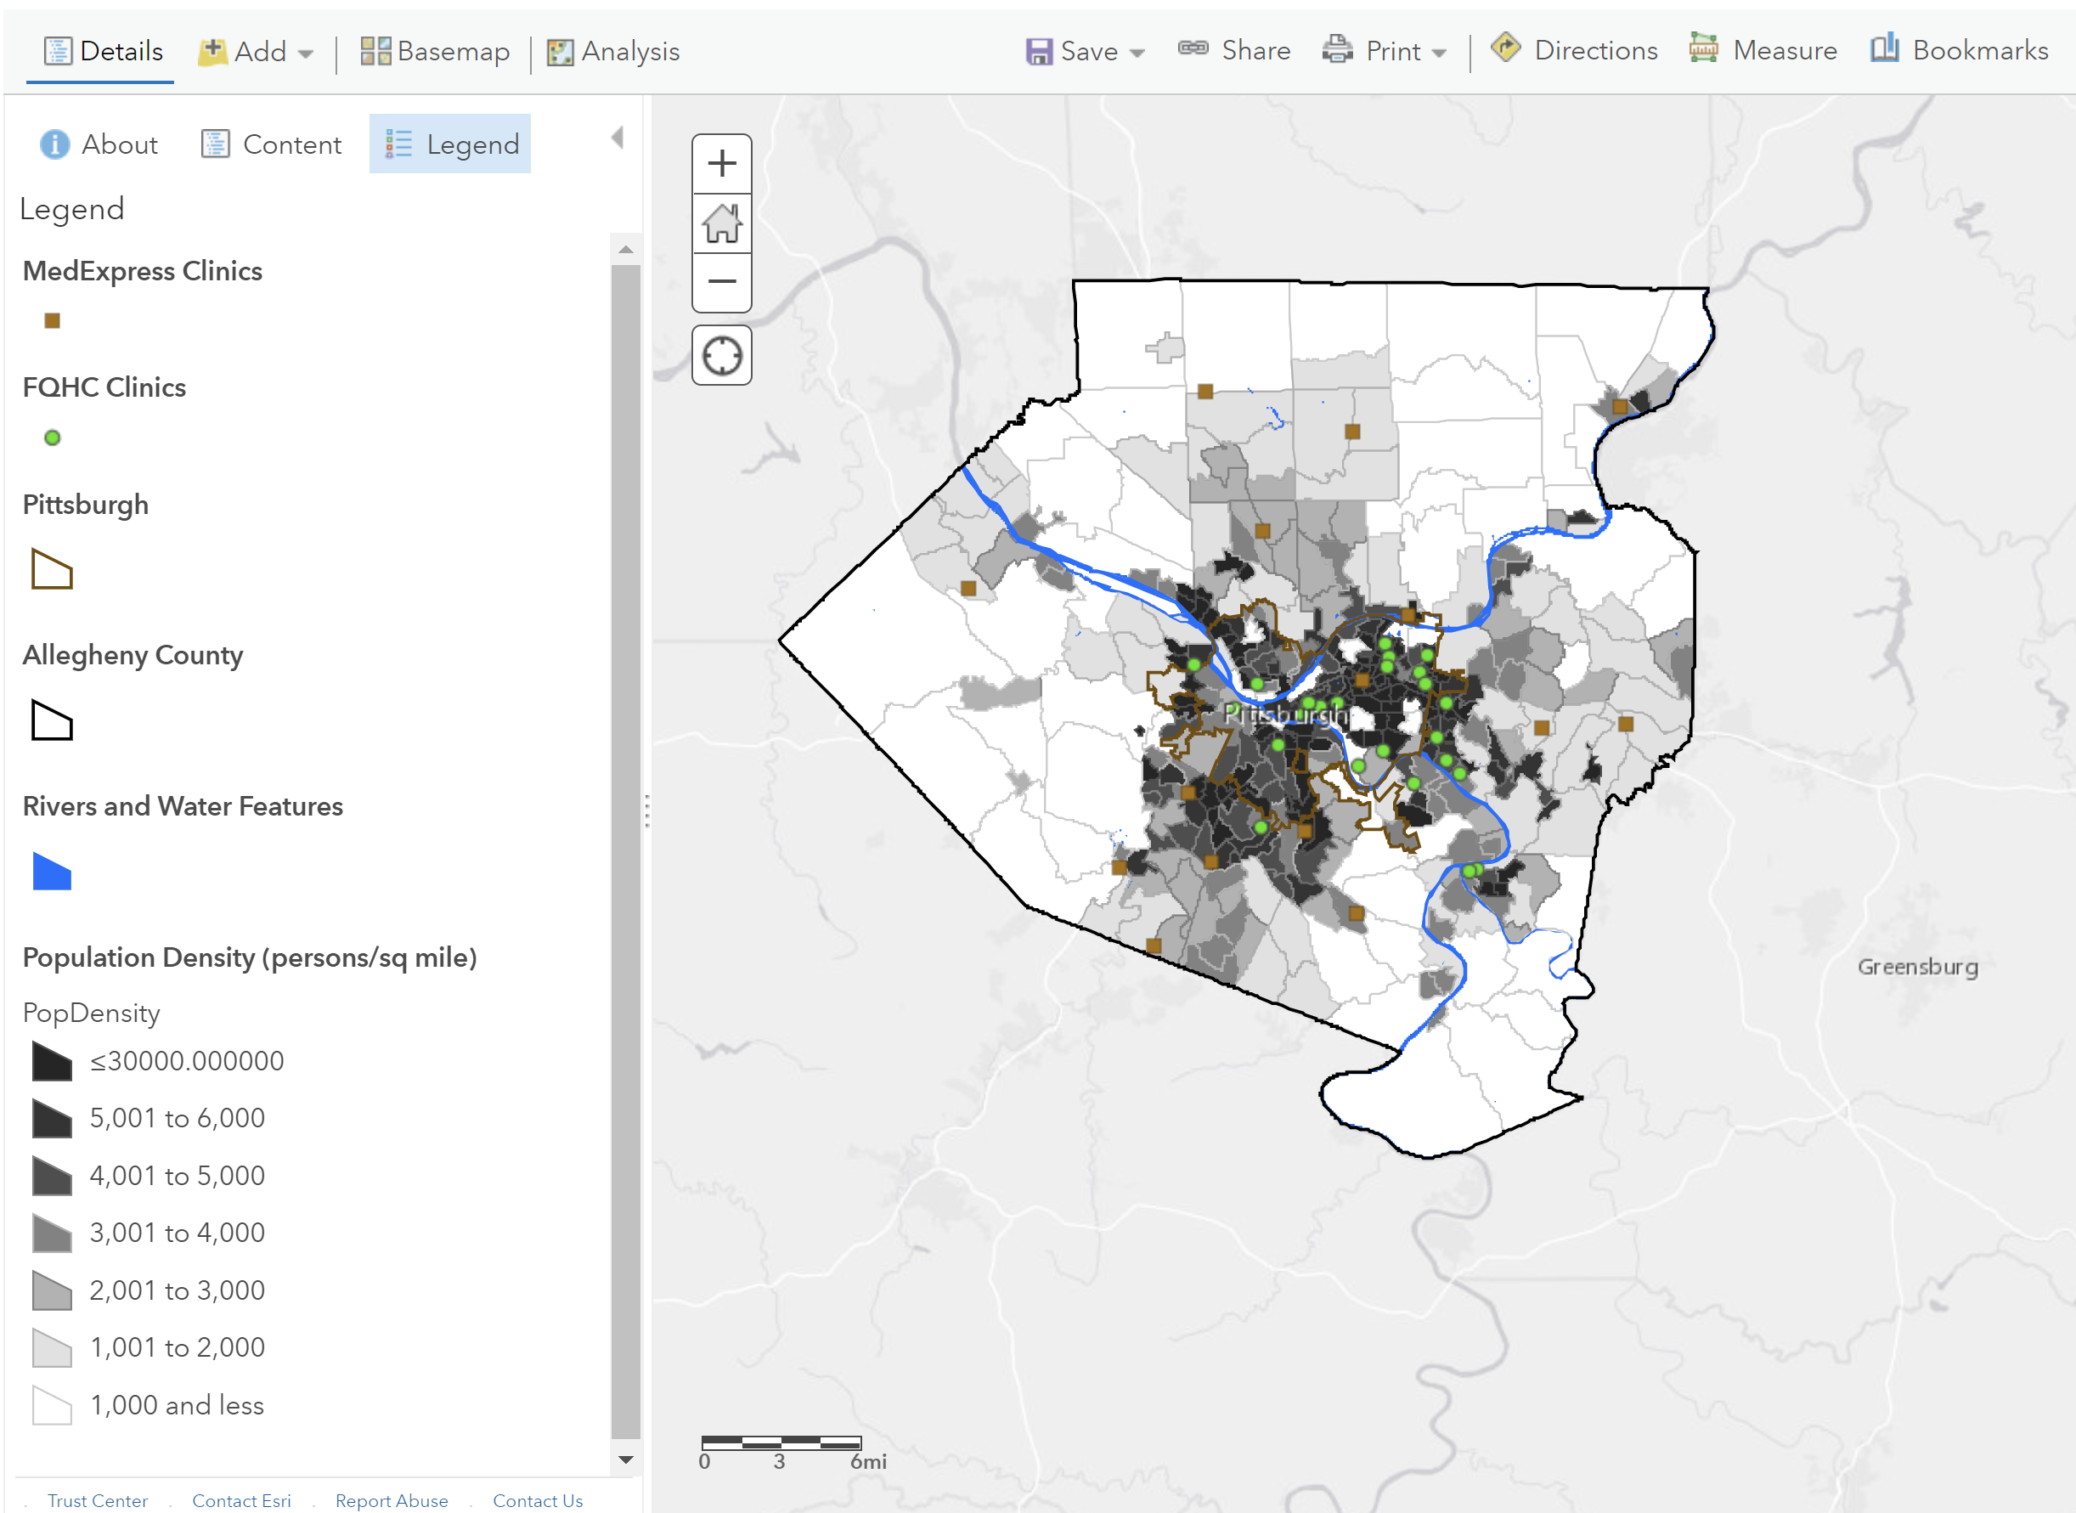
ArcGIS Online® (map viewer classic)
10

Slide 11
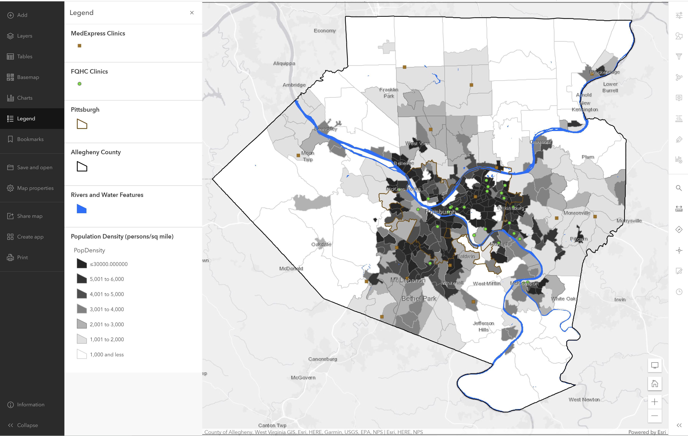
ArcGIS Map Viewer ®
11

Slide 12
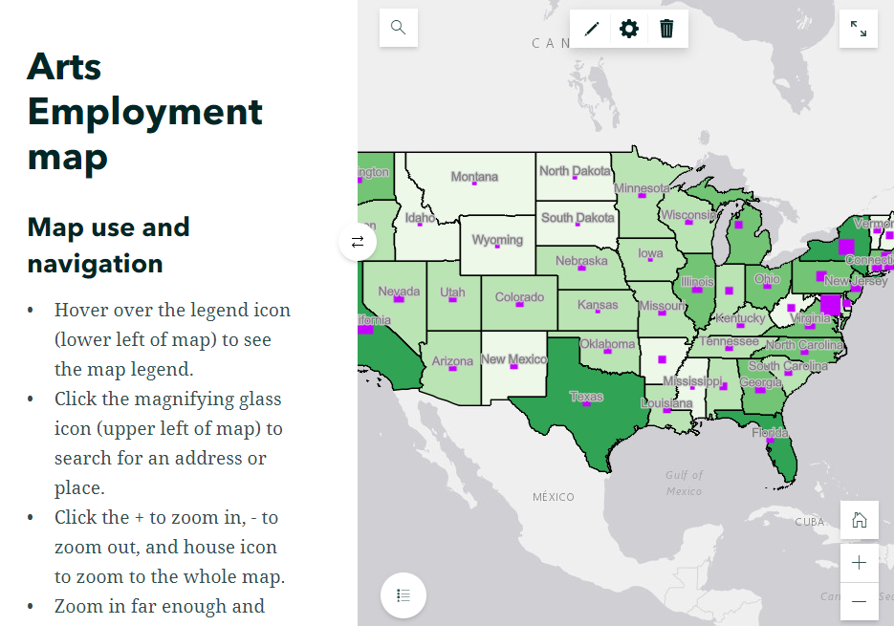
ArcGIS Story Maps®
Competition
12
12

Slide 13
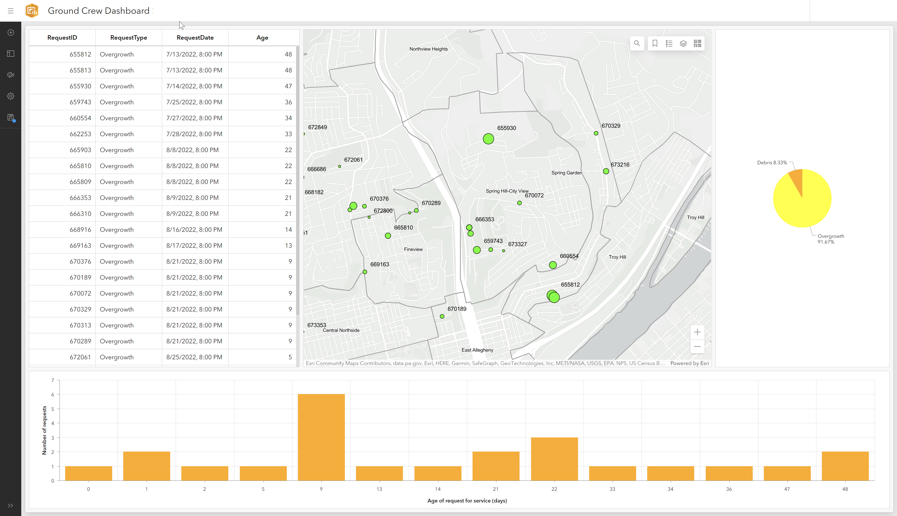
ArcGIS
Dashboard®
13

Slide 14
2.4 Lab session

Slide 15
Lab 01: Introduction to ArcGIS Pro
Due by Midnight (11:59 pm) on Monday, Sep 1, 2025
Submit a word document only include question and answer

